Slide 1
Presentation of design solution Search and Rescue Metal Detection Robot Alpha Team
Oct 6th2020

Slide 2
Alpha Team Members
Team Structure
Project Manager
Joseph Nirmalraj
Clients
Software Chief Engineer
Milan Serfaty
Hardware Chief Engineer
Hang Ye
Testing Chief Engineer
Yujia Zhang

Slide 3
Introduction
General facts about our project,
Implementation of bresenham's line algorithm or dead reckoning to explore the area
IR sensors to determine whether object is present
Inductive proximity sensor to detect metal targets
Achieve degree of rotation and move by Myblock or EV3 simulator or specific algorithm
Sensor Information feedback and decision making
Integration of Lego Ev3 and GUI for the remote system (GUI)
Possibility of using http://bricxcc.sourceforge.net/ - Lego BricxCC IDE
Explore and possibility of using Ev3 programming software with python programming

Slide 4
Best team to do this Project
Common goal
Open communication
Dedication on the schedule
Great vision to hit the market by unique requirements
Transparency
Time management
Group Involvement
Problem solving skills
Rapid learning curve
Ready to accept challenges
Coordination

Slide 5
Design specifications/Requirements
Contract : Create a robot that can search, detect and pick up all metallic objects in a given area
Bronze :
The robot is able to autonomously explore the area and detect metal objects
The robot is able to home in on the target
Silver :
The robot is able to pick up the object and get back to his starting point
He is able to choose between multiple search path depending on the situation
Gold :
The robot is able to discriminate the picked up objects by checking their color, and prioritize targets
Platinum :
The robot is able to report to a remote system, with a graphical user interface.

Slide 6
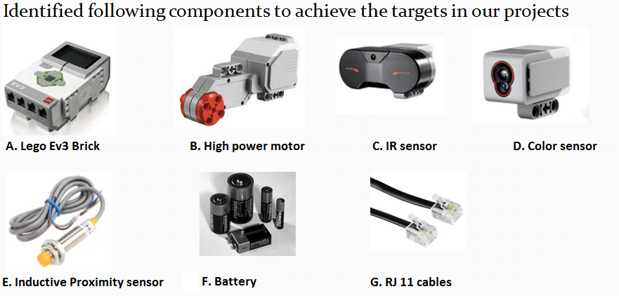
Hardware Prerequisites

Slide 7
General architecture
Wheels Connected
Motor 1
Infrared sensor 1
Lego EV3 Brick
Wheels Connected
Motor 2
Inductive proximity sensor 1
GUI
External Main storage OS
Comm Bus
Internal Module
SD card module
Speaker module

Slide 8
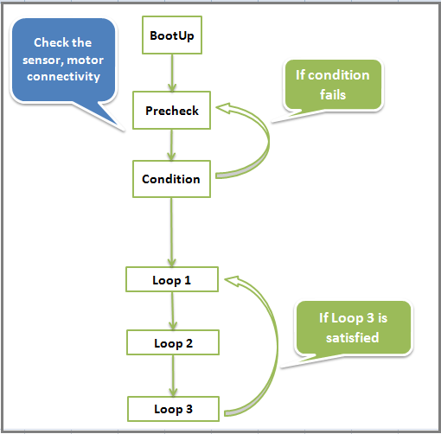
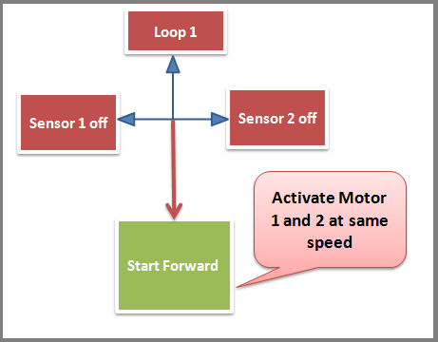
Software Design Diagram

Slide 9
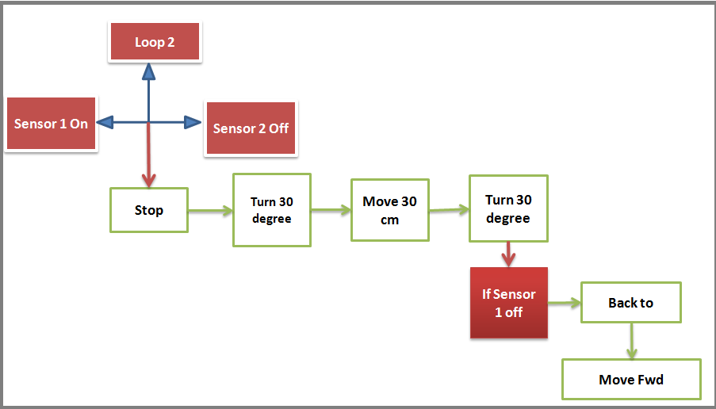
Software Design Diagram

Slide 10
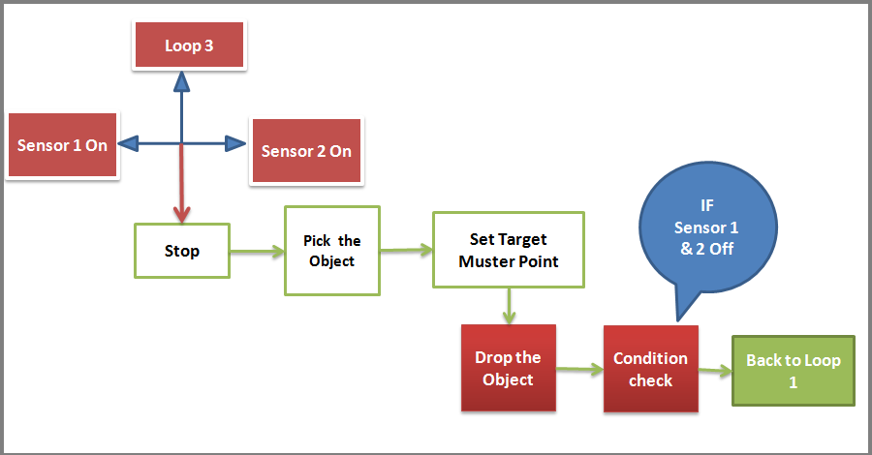
Software Design Diagram

Slide 11
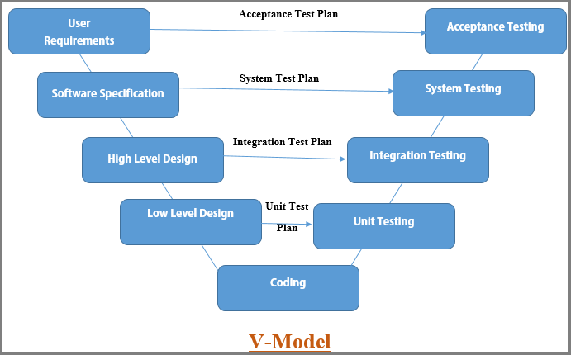
Validation Plan

Slide 12
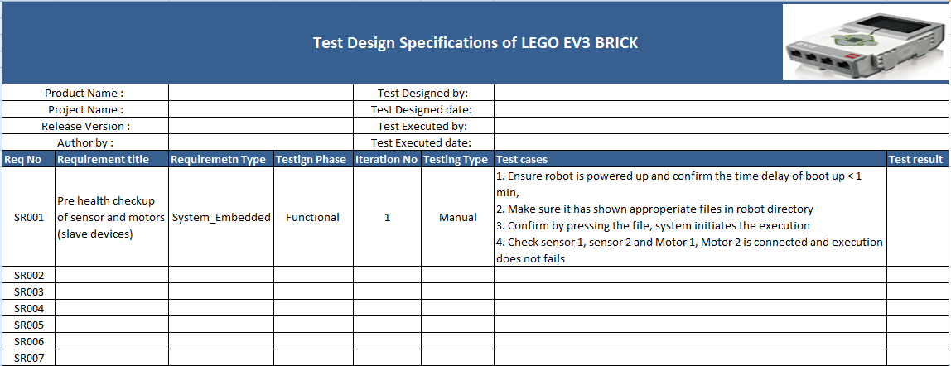
Test Suite document

Slide 13
Sample Validation Design
Contract :
The System shall be able to move automatically to find the target and takes corrective actions
Design :
[D-01] The System is a robot with several wheels , motors and a power source to move and stop.
[D-02] The System is a robot with an IR sensor to detect the object.
[D-03] The System is a robot with a programmable control system.
Specification :
[REQ-01] The System shall move forward.
[REQ-02] The System shall be able to detect the object in front of it.
[REQ-03] The System shall stop at a short distance from the object.

Slide 14
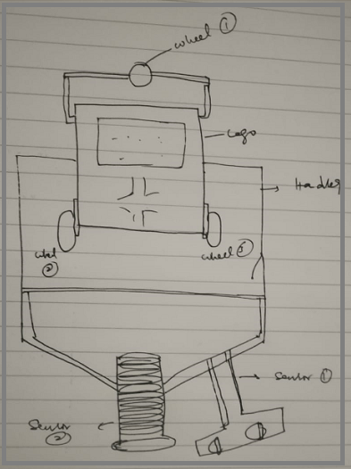
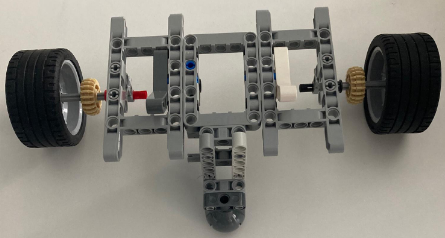
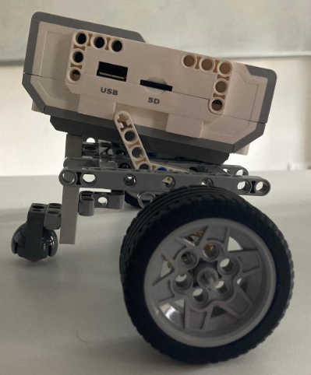
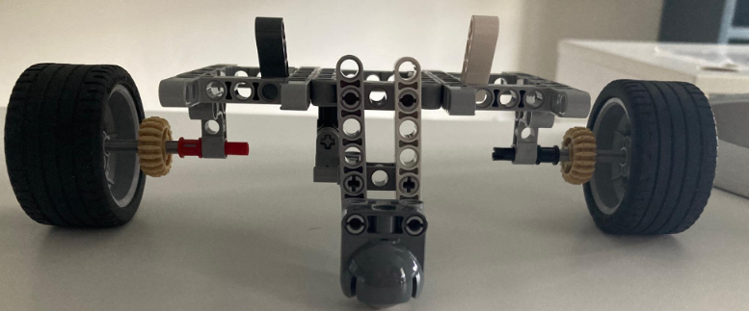
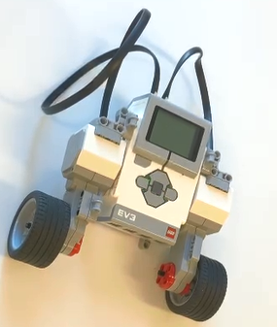
Hardware Structure
Sketch design Prototype In progress

Slide 15
Designing Hardware Requirements
1. Move back and forth:
The front and back movement of the trolley is based on the forward and reverse rotation of the motor, and the motor is used to drive the trolley to move.
2. Steering action
At present, many assumptions have been put forward for steering.
Method 1: Use structures (such as bearings, gears, universal wheels) to steer the car.
Method 2: Through the opposite rotation of the wheels on both sides, that is, the two motors rotate in opposite directions to control the car to turn left and right.
Method 3: Realize the lateral movement of the trolley through auxiliary wheels.

Slide 16
Designing Hardware Requirements
3. Calibration part:
Considering that we place the two sensors in front of the trolley, it is not easy to add a picking robotic arm in the front, so the robotic arm can be placed behind the trolley.
But this requires the trolley to rotate 180°in place. Placed on the side, the trolley also needs to adjust the position. Placed in the front, not only does not need to adjust the position, but also can jump directly to the picking program after detecting the target.
How to place it will require physical operation afterwards.
4. Picking part:
The current two design schemes are the clamping type and the lifting type.
After the calibration position is over, the robotic arm will clamp the target, but this is for regular objects, so we prefer the lifting method,
Using two larger shovel-shaped robotic arms to lift the target and transport it back to the place of departure.

Slide 17
Feasibility analysis (Requirement vs Implementation)
Roll | Identified Risk | Mitigate action or remarks
Sensor purchase (Inductive proximity sensor) | Cost nearly 12 to 15 Euro | Discussion required with clients
 | Supply voltage 10 to 30 VDC or 20 to 240 VAC | Pre-check required on the battery to supply or we need external power source
Pick the object and drop requirement | Hardware design specifications | Internal
Graphical user interface | Communication between Lego Ev3 and system (user interface) while metal identified | Internal

Slide 18
Alpha team progress
..\Alpha robot_Progress.mp4

Slide 19
Conclusion
Concluding in our project, we are dealing with known set of requirements to reduce the risks and targeting to achievable challenges
Thanks to everyone for your time and listening our presentation patiently.

